Slide 1
Add a Second LED
Program an LED Light Show

Slide 2
Using what you have learned so far, try to add a second LED to your circuit, without looking ahead in the slides.
Modify your code to make the second LED blink on and off at the same time as the first LED.
Hint: you can do this just by copy-pasting lines of code in the example program. All you need to do is change the pin number.
No cheating! Try to figure it out yourself before you look ahead!

Slide 3
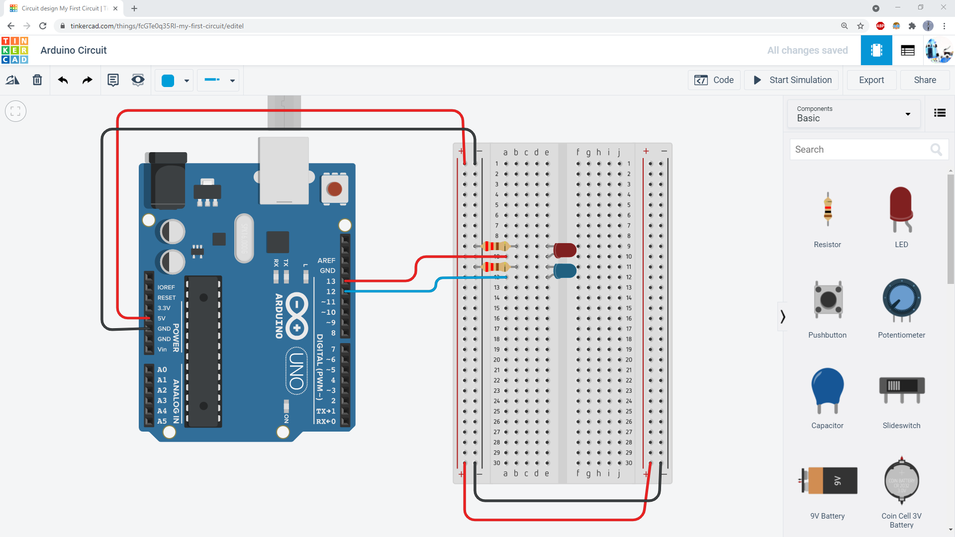
This circuit shows how to connect a second LED to Arduino pin 12, but you do not have to use pin 12. You can use a different pin if you want to.
Don’t forget the resistor!

Slide 4
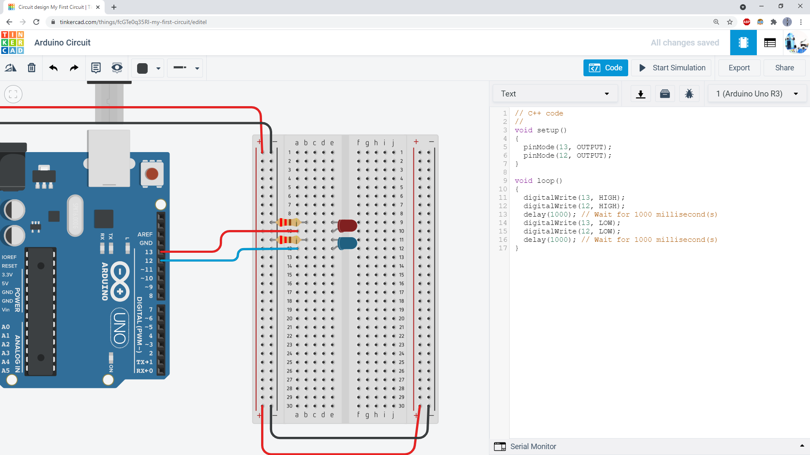
This program shows how to modify the code to also blink the LED on pin 12. All you need to do is copy/paste the pinMode and digitalWrite commands, then change the 13 to a 12.
If you connected your LED to a different Arduino pin, you would use a different number here.

Slide 5
It is a good habit to add comments to your code that explain what it does. This helps you remember what your code does if you come back to it later, and helps other people understand your code when they read it. Try adding a comment to every single line of your code.

Slide 6
For an added challenge, try changing the code so the LEDs blink out of sync (one LED is on while the other is off).

Slide 7
This code blinks the LEDs out of sync. Note how the HIGH and LOW have been switched on lines 14 and 17.

