Slide 1
Blink an LED
Program an LED Light Show

Slide 2
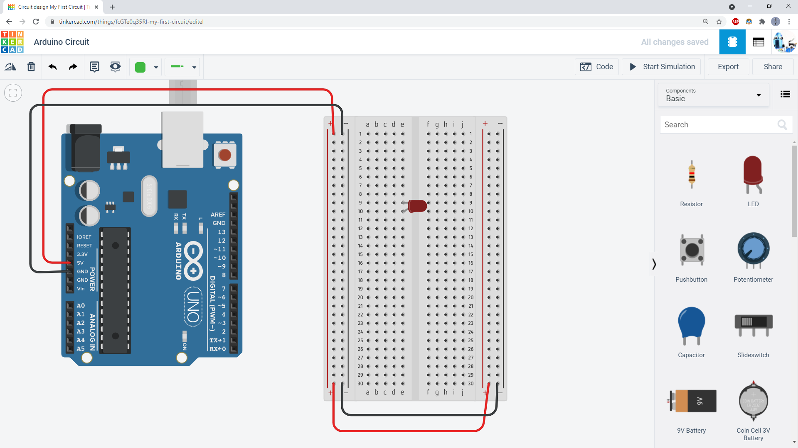
Add an LED to your circuit. Rotate it so its two legs fit into two different breadboard rows.

Slide 3
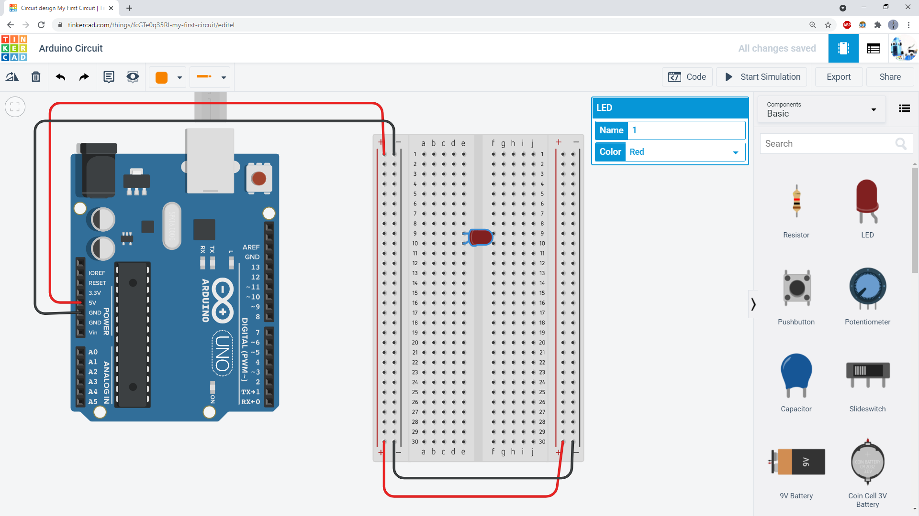
Optional: Click the LED, then use the dropdown menu to change its color.

Slide 4
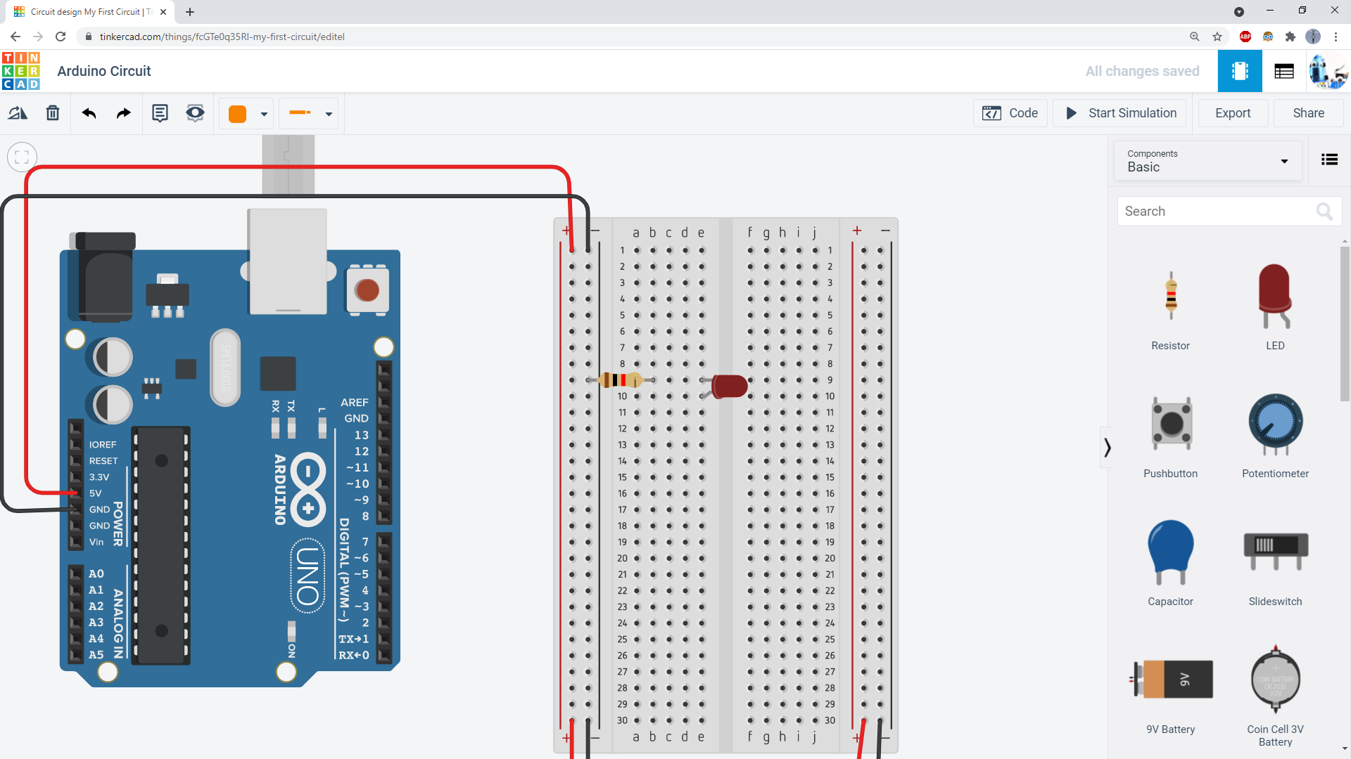
Add a resistor between the short leg of the LED and the ground bus. Make sure the resistor and the short leg of the LED are in the same breadboard row.

Slide 5
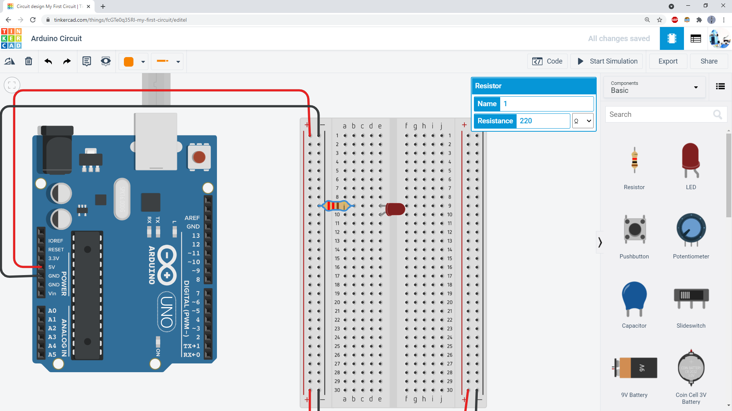
Click on the resistor. Use the pop-up window to change its value to 220Ω.
Ω is the capital Greek letter Omega. It stands for ohms, the unit used to measure resistance.

Slide 6
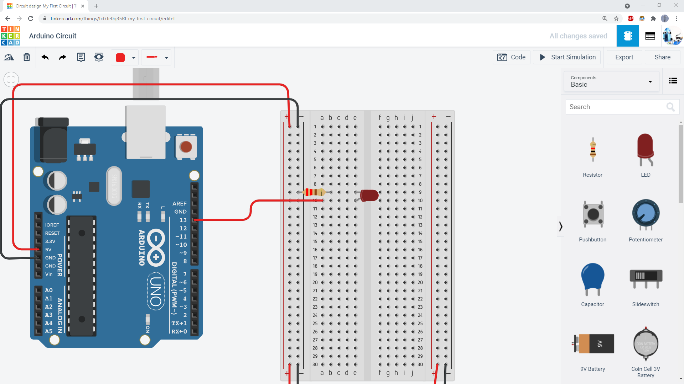
Add a wire from Arduino pin 13 to the long leg of the LED.

Slide 7
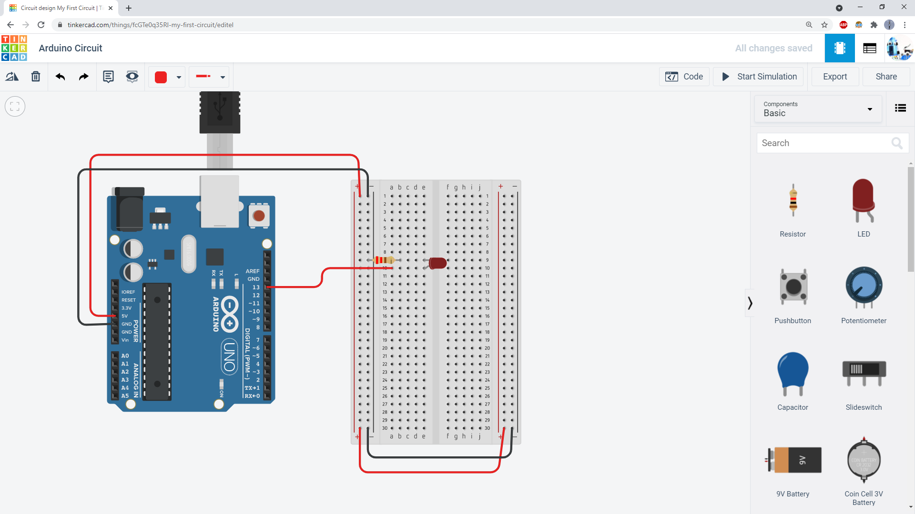
Click the “Code” button.

Slide 8
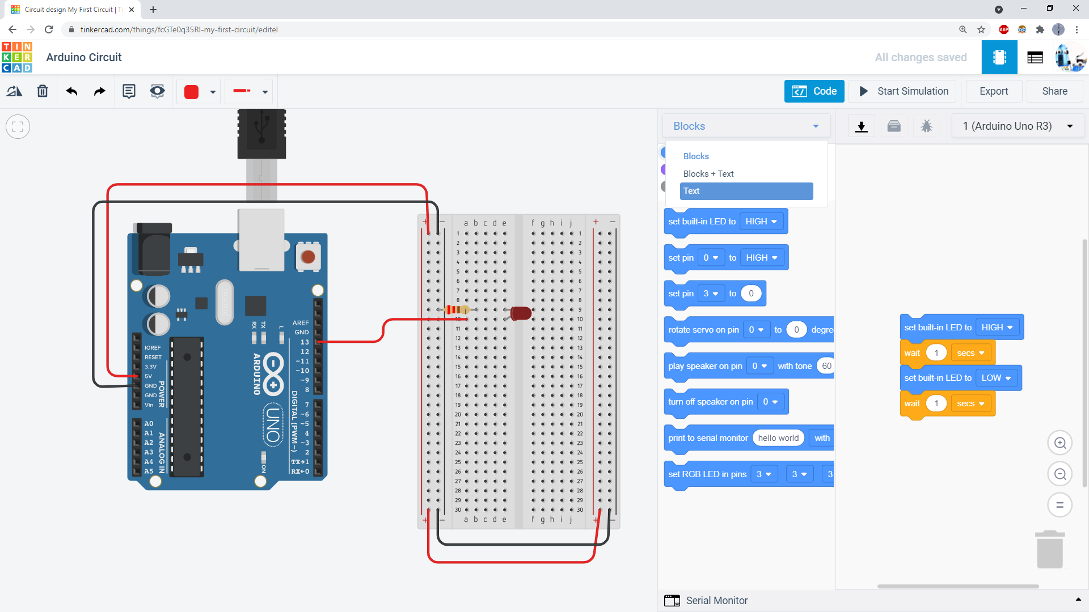
Click the drop-down menu and select “Text.”

Slide 9
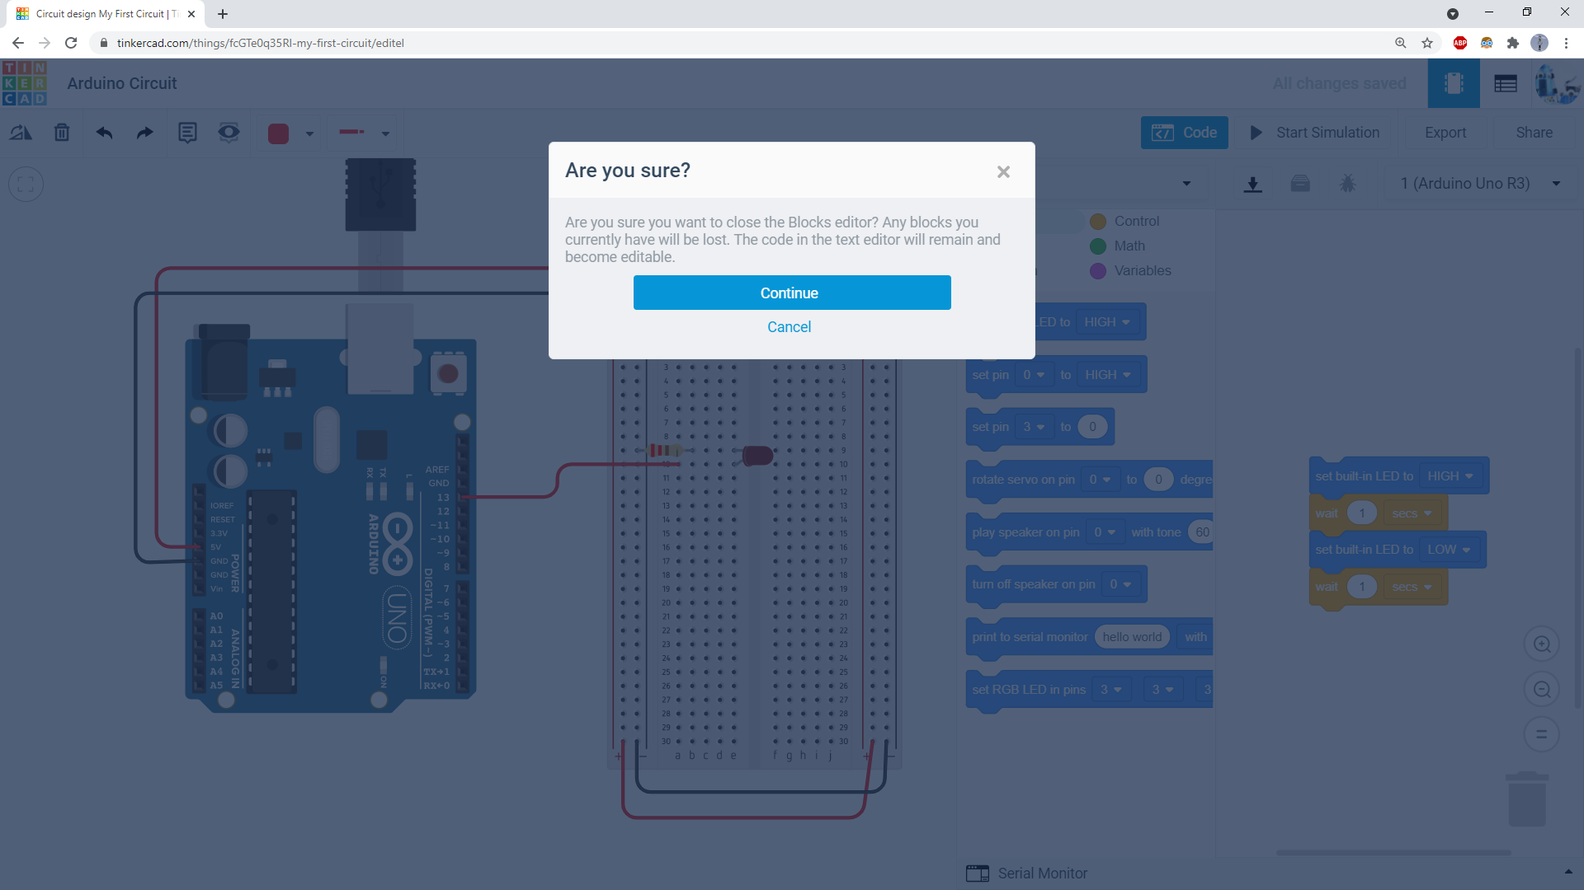
Click “Continue.”

Slide 10
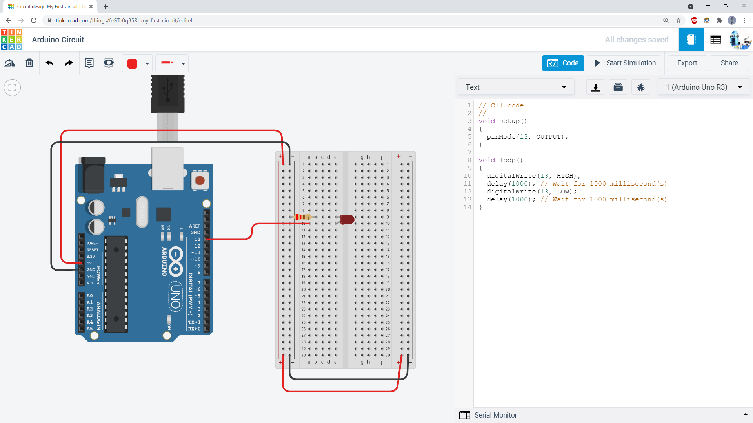
Code in the setup function only runs once. It uses the pinMode command to tell the Arduino to use pin 13 as an output.
Code in the loop() function runs over and over again forever. It uses the digitalWrite command to turn the LED on or off (high or low), and the delay command to make the code wait for a certain amount of time. This code tells the Arduino to turn the LED on, wait one second (1000 milliseconds), turn the LED off, wait one second, and repeat.

Slide 11
Click the “Start Simulation” button and your LED should blink on and off.

Slide 12
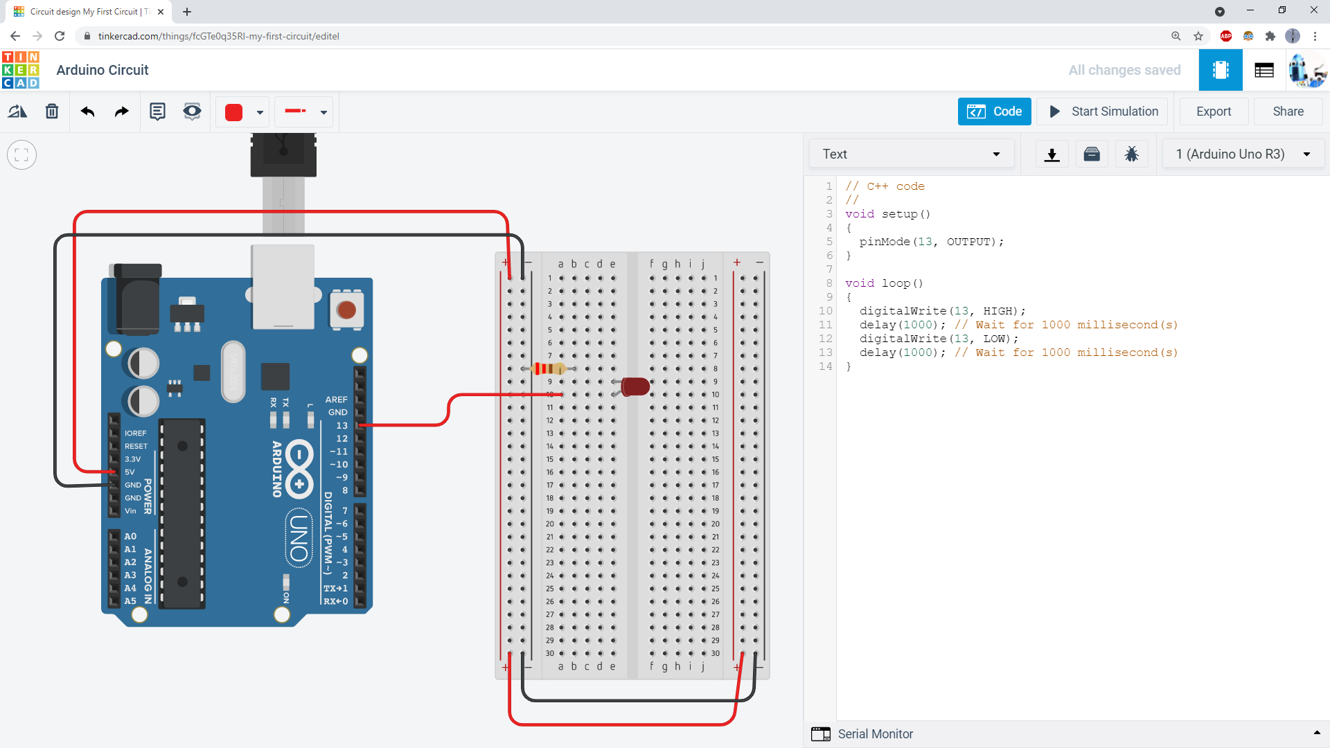
If your LED does not blink, carefully double-check your breadboard wiring. For example, can you tell what is wrong with this circuit? (go to next slide for answer)

Slide 13
The resistor is not in the same row as the short leg of the LED. They are not connected. This is an open circuit, so the LED will not light up.

Slide 14
How about this circuit? Can you tell what is wrong here? (Go to next slide for answer.)

Slide 15
Both legs of the LED are in the same breadboard row. These holes are connected to each other, so this creates a short circuit. The LED will not light up.

Slide 16
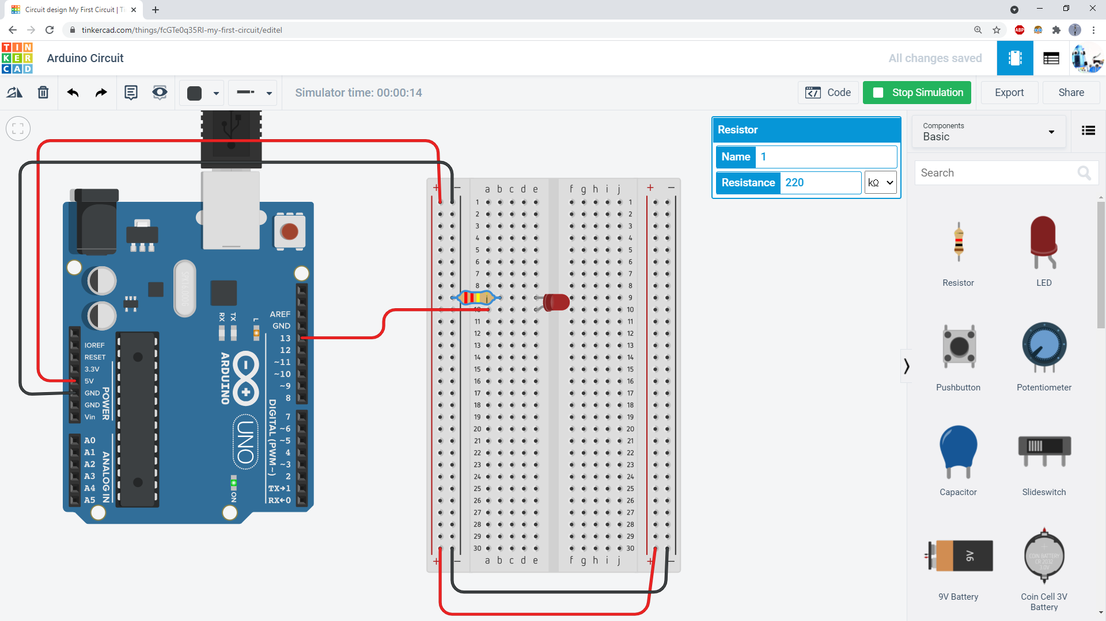
If your LED looks very dim, make sure you have your resistor set to 220Ω and not 220kΩ.

